Slide 1

C Project 2023 PPIM
Ghassen Faidi T3G2

Slide 2
Concept: Hospital Management
My project is a console application written in C language. It aims to simplify the communication and interaction between administrators, doctors and patients. The project provides an interface that can be used to manipulate data and execute specific tasks if access is granted (authentication). The project is divided into three main sections, Administrator, Doctor and Patient sections.

Slide 3
Libraries and Header Files <.h>
I used many libraries to help me throughout the project:
- Standard <locale.h> <stdio.h> <string.h> <stdlib.h> <time.h>
- External: hpdf.h pour generer les fichiers PDF
- User-defined: structures.h which contains user-defined data structures

Slide 4

Setting up LibHaru (hpdf.h)
LibHaru is a great open-source C/C++ library to create PDF files.
I faced many problems when installing this library. First of all, I had to install a package manager to simplify the installation process, I used vcpkg package manager and installed LibHaru.
After that, I had to set up the library and link it to Visual Studio, I modified the settings in the Proprieties window:
Added the library folder in VC++ > Included Directories
Added the library’s “include” folder in the C/C++ panel
Added the library’s lib folder in the Linker panel

Slide 5
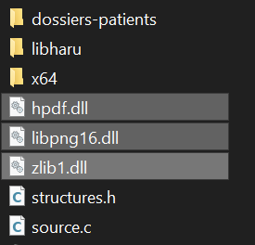
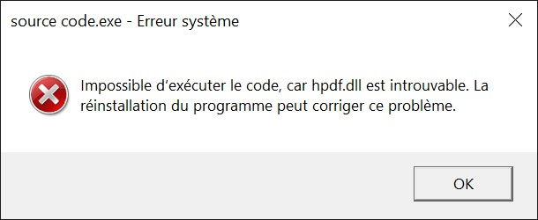
Added the library’s lib folder in the Linker panel
Without the DLL files we get errors, since the library’s functionality depends on them.

Slide 6
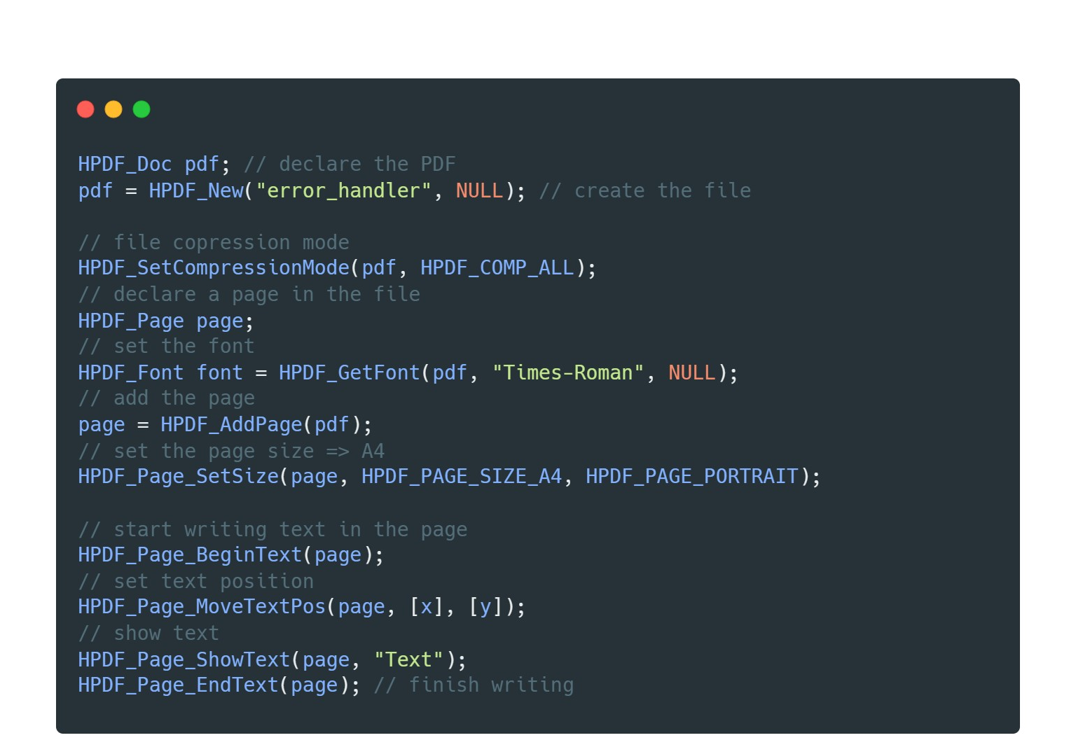
LibHaru Built-in functions

Slide 7
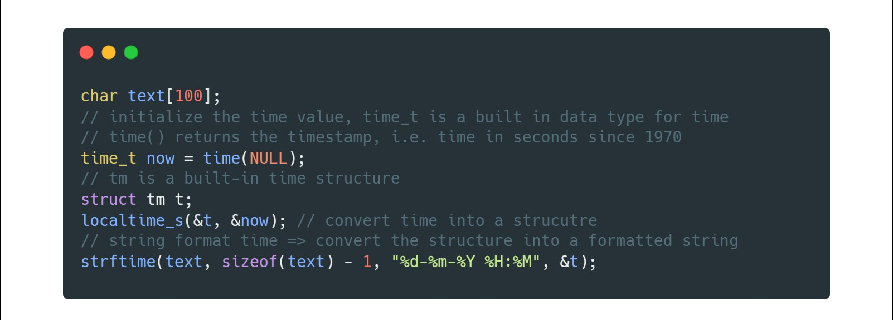
<time.h>
I also needed to create a string containing the current date and type, subsequently I needed the standard library <time.h>

